Slide 1
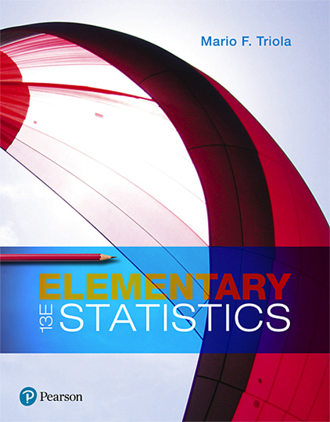
Elementary Statistics
Thirteenth Edition
Chapter 9
Inferences from Two Samples
Copyright © 2018, 2014, 2012 Pearson Education, Inc. All Rights Reserved

Slide 2
Inferences from Two Samples
9-1 Two Proportions
9-2 Two Means: Independent Samples
9-3 Two Dependent Samples (Matched Pairs)
9-4 Two Variances or Standard Deviations

Slide 3
Key Concept
In this section we present the F test for testing claims made about two population variances (or standard deviations). The F test (named for statistician Sir Ronald Fisher) uses the F distribution introduced in this section. The F test requires that both populations have normal distributions. Instead of being robust, this test is very sensitive to departures from normal distributions, so the normality requirement is quite strict.

Slide 4
Hypothesis Test with Two Variances or Standard Deviations: Objective
Conduct a hypothesis test of a claim about two population variances or standard deviations. (Any claim made about two population standard deviations can be restated with an equivalent claim about two population variances, so the same procedure is used for two population standard deviations or two population variances.)

Slide 5
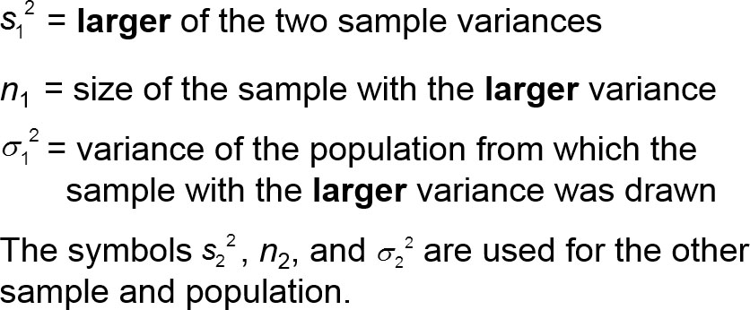
Hypothesis Test with Two Variances or Standard Deviations: Notation

Slide 6
Hypothesis Test with Two Variances or Standard Deviations: Requirements
The two populations are independent.
The two samples are simple random samples.
Each of the two populations must be normally distributed, regardless of their sample sizes. This F test is not robust against departures from normality, so it performs poorly if one or both of the populations have a distribution that is not normal. The requirement of normal distributions is quite strict for this F test.

Slide 7
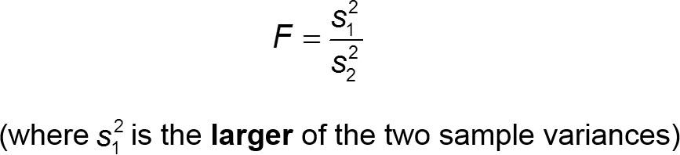
Hypothesis Test with Two Variances or Standard Deviations: Test Statistic for Hypothesis Tests with Two Variances (with H₀: sigma 1 squared equal to sigma 2 squared) (1 of 4)
P-Values: P-values are automatically provided by technology. If technology is not available, use the computed value of the F test statistic with Table A-5 to find a range for the P-value.

Slide 8
Hypothesis Test with Two Variances or Standard Deviations: Test Statistic for Hypothesis Tests with Two Variances (with H₀: sigma 1 squared equal to sigma 2 squared) (2 of 4)
Critical Values: Use Table A-5 to find critical F values that are determined by the following:
The significance level α (Table A-5 includes critical values for α = 0.025 and α = 0.05.)
​​​Numerator degrees of freedom n₁ − 1 (determines column of Table A-5)

Slide 9
Hypothesis Test with Two Variances or Standard Deviations: Test Statistic for Hypothesis Tests with Two Variances (with H₀: sigma 1 squared equal to sigma 2 squared) (3 of 4)
​​Denominator degrees of freedom n₂ − 1 (determines row of Table A-5) For significance level α = 0.05, refer to Table A-5 and use the right-tail area of 0.025 or 0.05, depending on the type of test, as shown below:
Two-tailed test: Use Table A-5 with 0.025 in the right tail. (The significance level of 0.05 is divided between the two tails, so the area in the right tail is 0.025.)
One-tailed test: Use Table A-5 with α = 0.05 in the right tail.

Slide 10
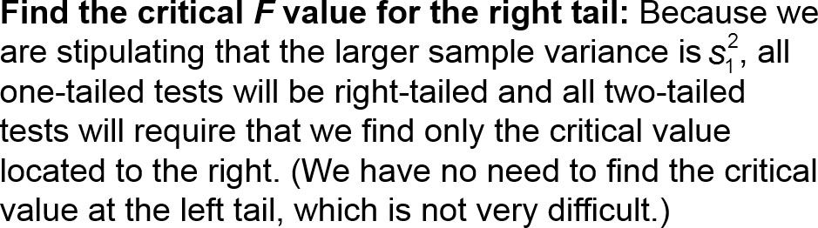
Hypothesis Test with Two Variances or Standard Deviations: Test Statistic for Hypothesis Tests with Two Variances (with H₀: sigma 1 squared equal to sigma 2 squared) (4 of 4)

Slide 11
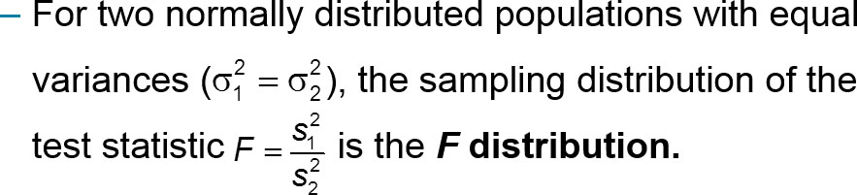
F Distribution (1 of 2)
F Distribution

Slide 12
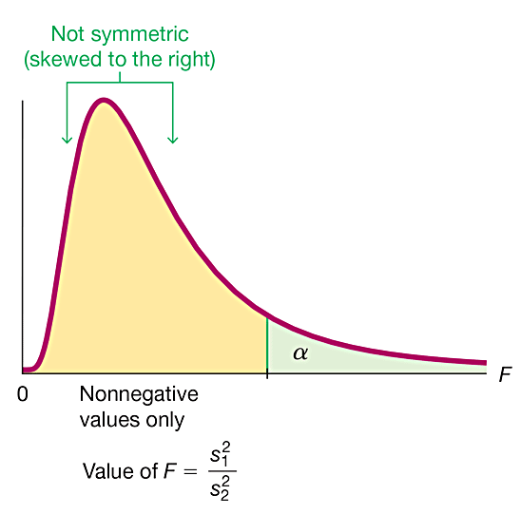
F Distribution (2 of 2)
There is a different F distribution for each different pair of degrees of freedom for the numerator and denominator.
The F distribution is not symmetric.
Values of the F distribution cannot be negative.
The exact shape of the F distribution depends on the two different degrees of freedom.

Slide 13
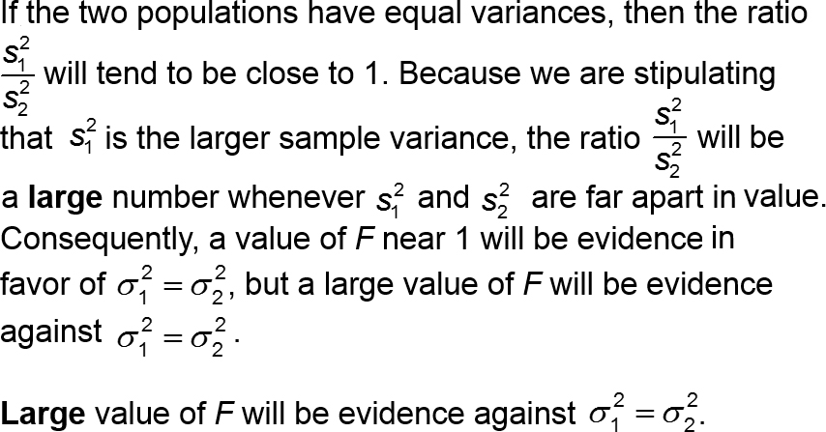
Interpreting the Value of the F Test Statistic

Slide 14
Example: Course Evaluation Scores (1 of 9)
Listed below are the same student course evaluation scores used in Section 9-2, where we tested the claim that the two samples are from populations with the same mean. Use the same data with a 0.05 significance level to test the claim that course evaluation scores of female professors and male professors have the same variation.
Female | 4.3 | 4.3 | 4.4 | 4.0 | 3.4 | 4.7 | 2.9 | 4.0 | 4.3 | 3.4 | 3.4 | 3.3 | blank | Blank | blank
Male | 4.5 | 3.7 | 4.2 | 3.9 | 3.1 | 4.0 | 3.8 | 3.4 | 4.5 | 3.8 | 4.3 | 4.4 | 4.1 | 4.2 | 4.0

Slide 15
Example: Course Evaluation Scores (2 of 9)
Solution
REQUIREMENT CHECK (1) The two populations are independent of each other. The two samples are not matched in any way. (2) Given the design for the study, we assume that the two samples can be treated as simple random samples. (3) A normal quantile plot of each set of sample course evaluation scores shows that both samples appear to be from populations with a normal distribution.
The requirements are satisfied.

Slide 16
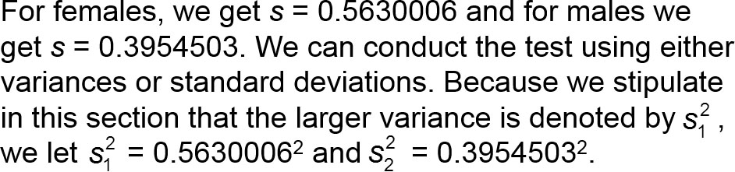
Example: Course Evaluation Scores (3 of 9)
Solution

Slide 17
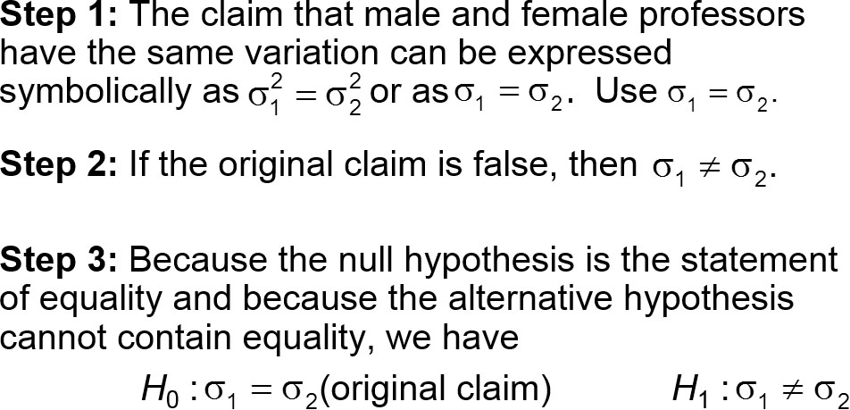
Example: Course Evaluation Scores (4 of 9)
Solution

Slide 18
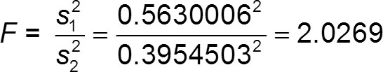
Example: Course Evaluation Scores (5 of 9)
Solution
Step 4: The significance level is α = 0.05.
Step 5: Because this test involves two population variances, we use the F distribution.
Step 6: The test statistic is

Slide 19
Example: Course Evaluation Scores (6 of 9)
Solution
P-Value Method For a two-tailed test with significance level 0.05, the area of 0.025 is in the right tail. With numerator degrees of freedom = n₁ − 1 = 11 and denominator degrees of freedom = n₂ − 1 = 14, we find that the critical value of F is between 3.1469 and 3.0502. The test statistic of F = 2.0269 is less than the critical value, so the area to the right of the test statistic is greater than 0.025, and for this two-tailed test, P-value > 0.05.

Slide 20
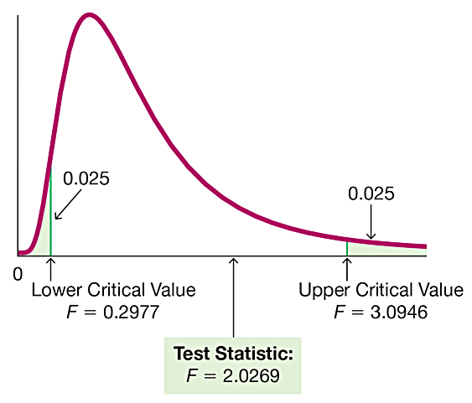
Example: Course Evaluation Scores (7 of 9)
Solution
Critical Value Method As with the P-value method, we find that the critical value is between 3.1469 and 3.0502. The test statistic F = 2.0269 is less than the critical value (which is between 3.1469 and 3.0502), so the test statistic does not fall in the critical region.

Slide 21
Example: Course Evaluation Scores (8 of 9)
Solution
Step 7: The test statistic F = 2.0269 does not fall within the critical region, so we fail to reject the null hypothesis of equal variances. There is not sufficient evidence to warrant rejection of the claim of equal standard deviations.

Slide 22
Example: Course Evaluation Scores (9 of 9)
Interpretation
Step 8: There is not sufficient evidence to warrant rejection of the claim that the two standard deviations are equal. Course evaluation scores of female professors and male professors appear to have the same amount of variation.

